Slide 1

WAY TO ENTERPRISE
Advanced Java
VTI ACADEMY
Author: duy.nguyenngoc1@vti.com.vn
March 2020

Slide 2
Agenda
Relationship Table
Foreign key
Assignments
Copyright © VTI Academy All Rights Reserved

Slide 3
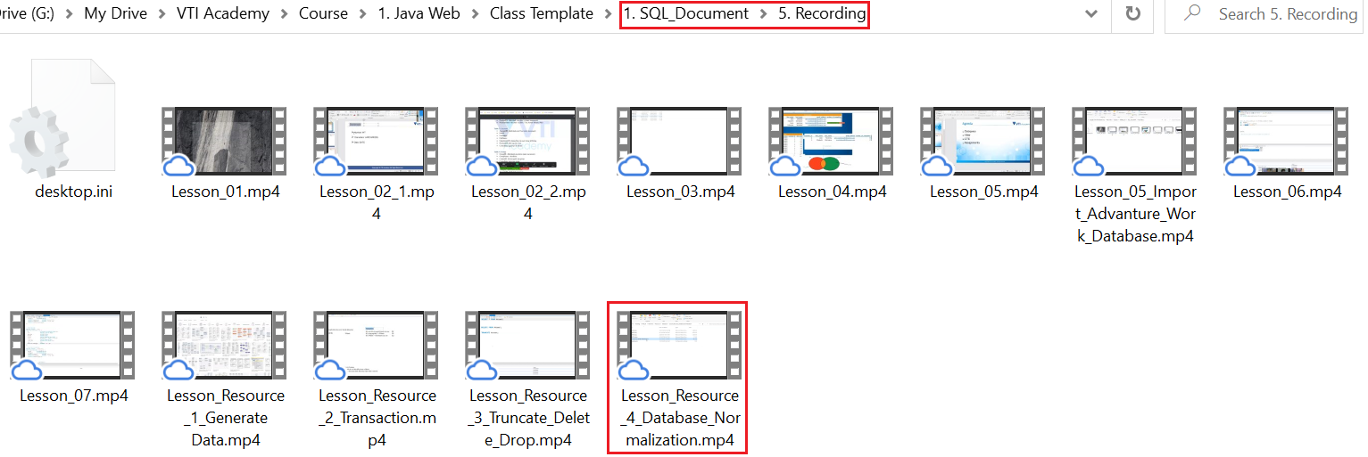
Relationship Table
3 types
1-1
1-n
n-n
https://drive.google.com/open?id=1y_HknAX8J2A0Av5DS1XPKa6bV0OcedgP

Slide 4
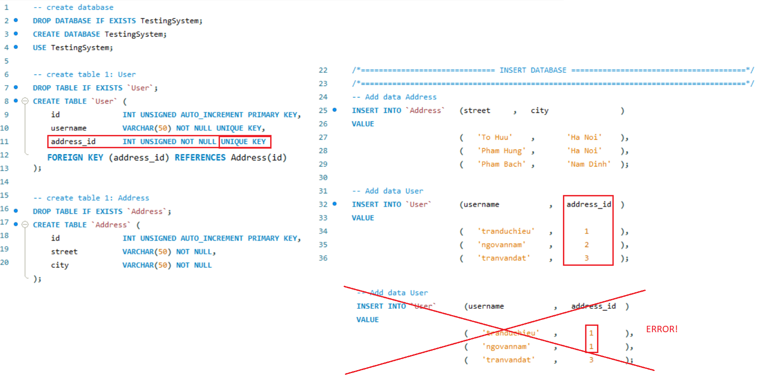
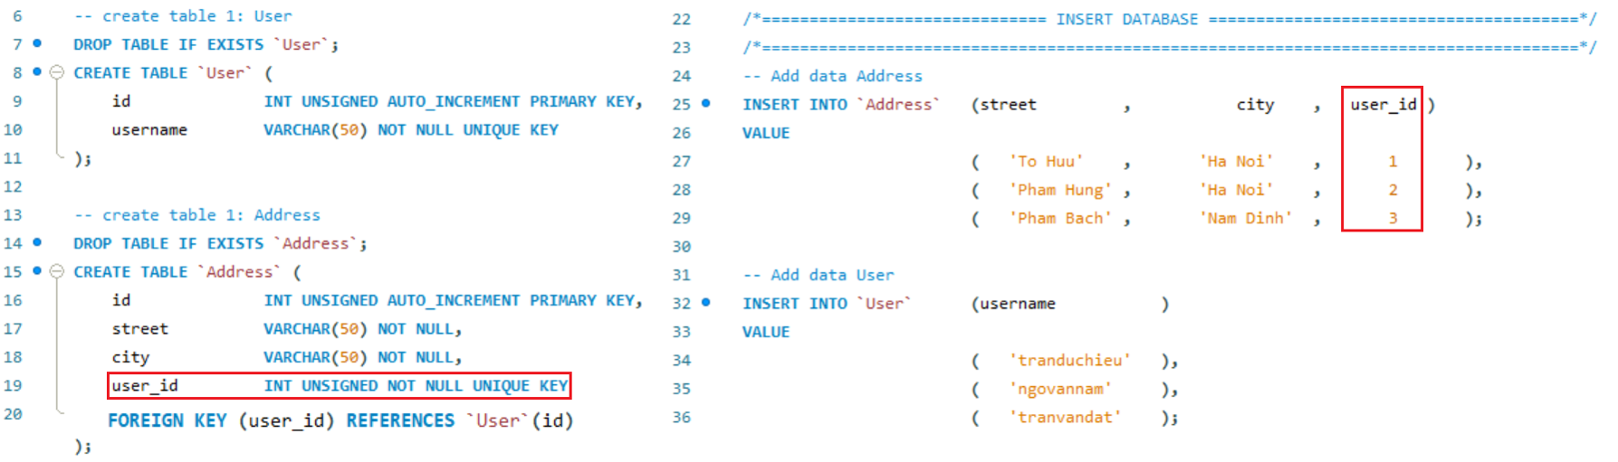
Relationship Table
1-1
Way 1
Way 2

Slide 5
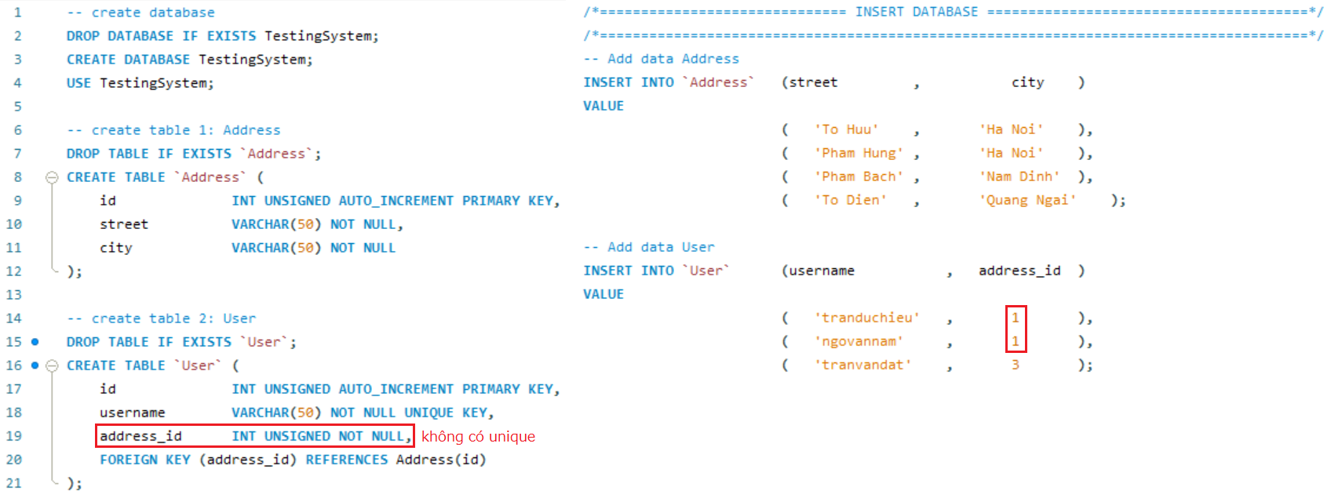
Relationship Table
1-n (n-1)
(Address) 1 - n (User)

Slide 6
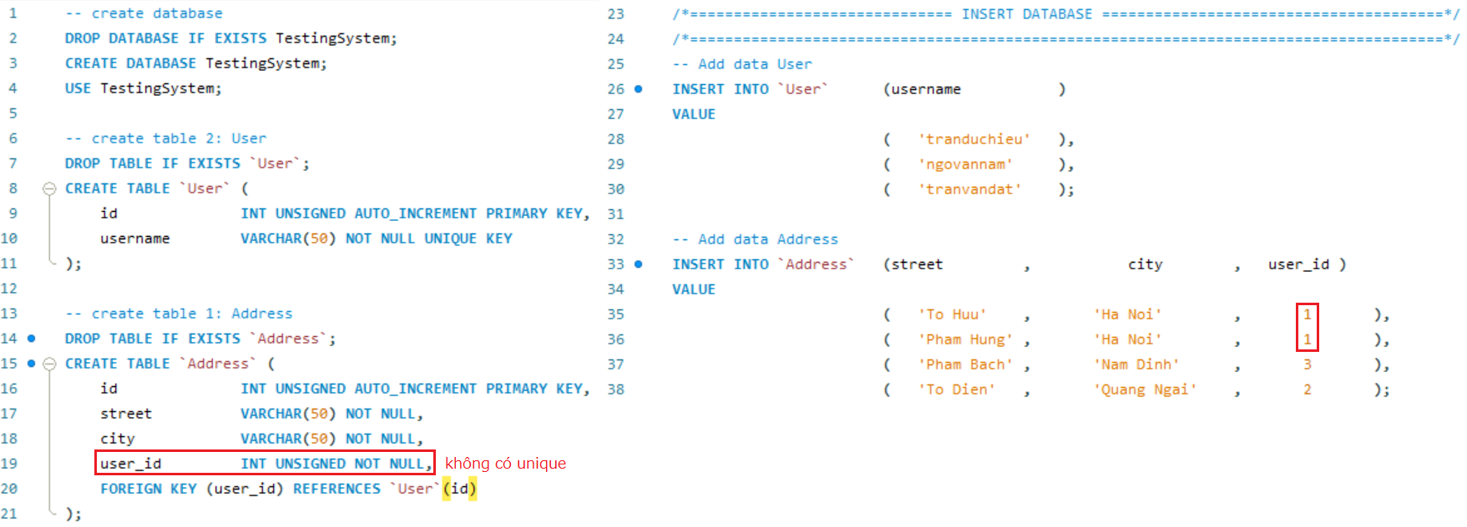
Relationship Table
(Address) n - 1 (User)

Slide 7
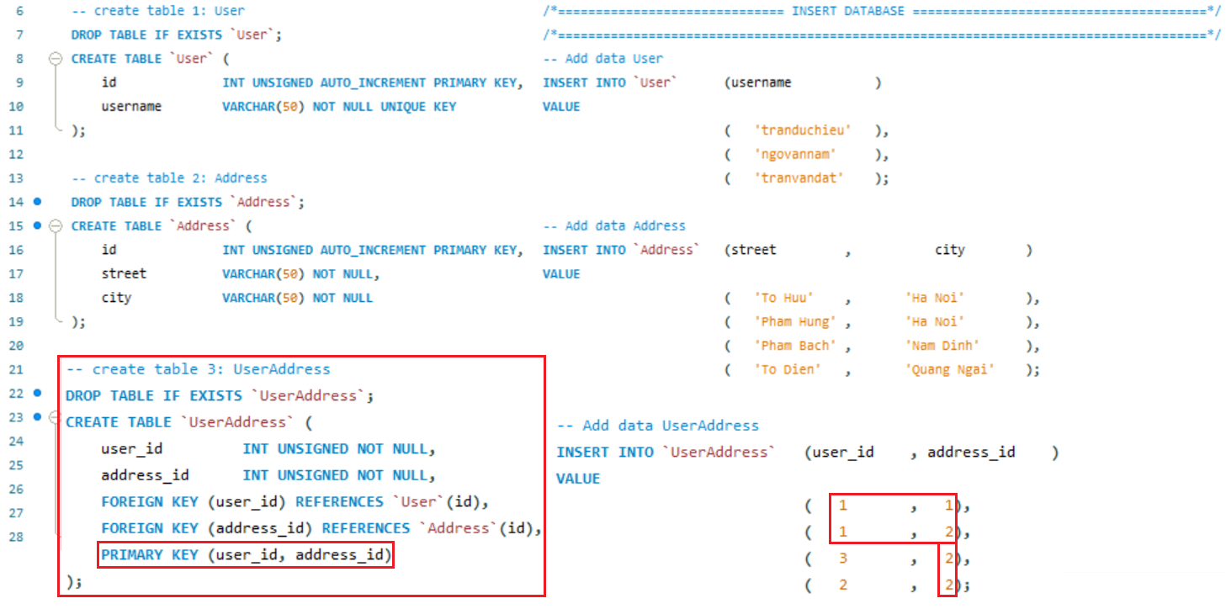
Relationship Table
n-n
(Address) 1 - n (User) & (User) 1 - n (Address)

Slide 8
Foreign key
3 types
@OneToOne
@OneToMany
@ManyToMany

Slide 9
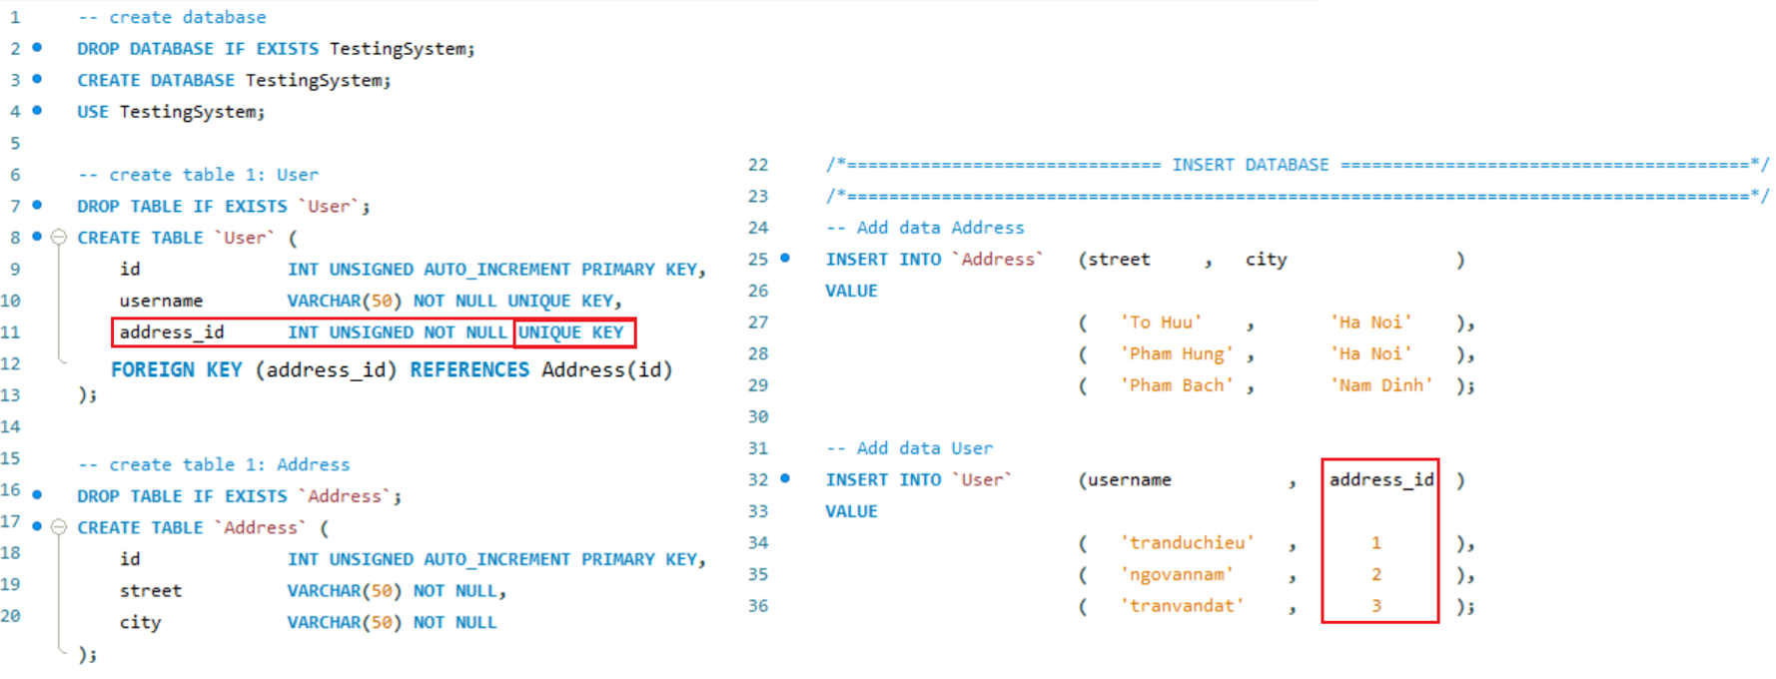
Foreign key
@OneToOne
Example 1:

Slide 10
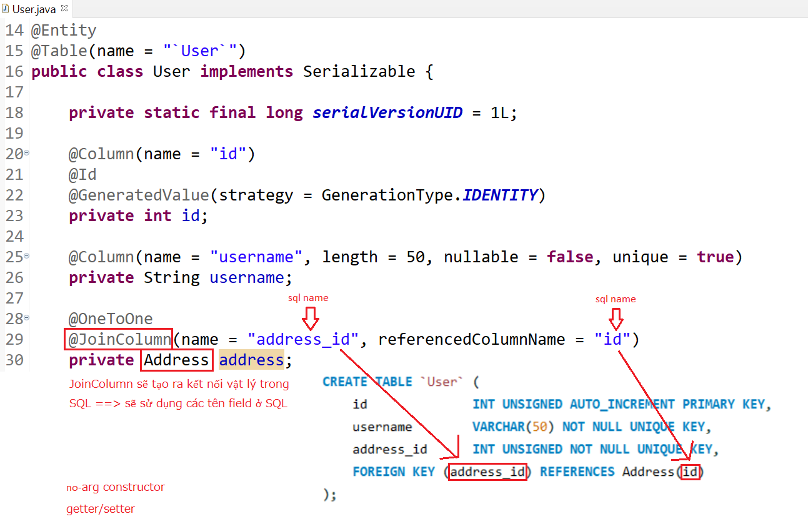
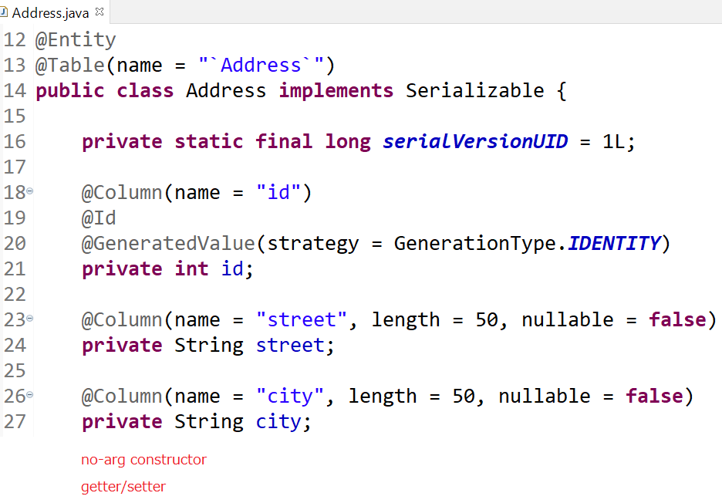
Foreign key
Entity

Slide 11
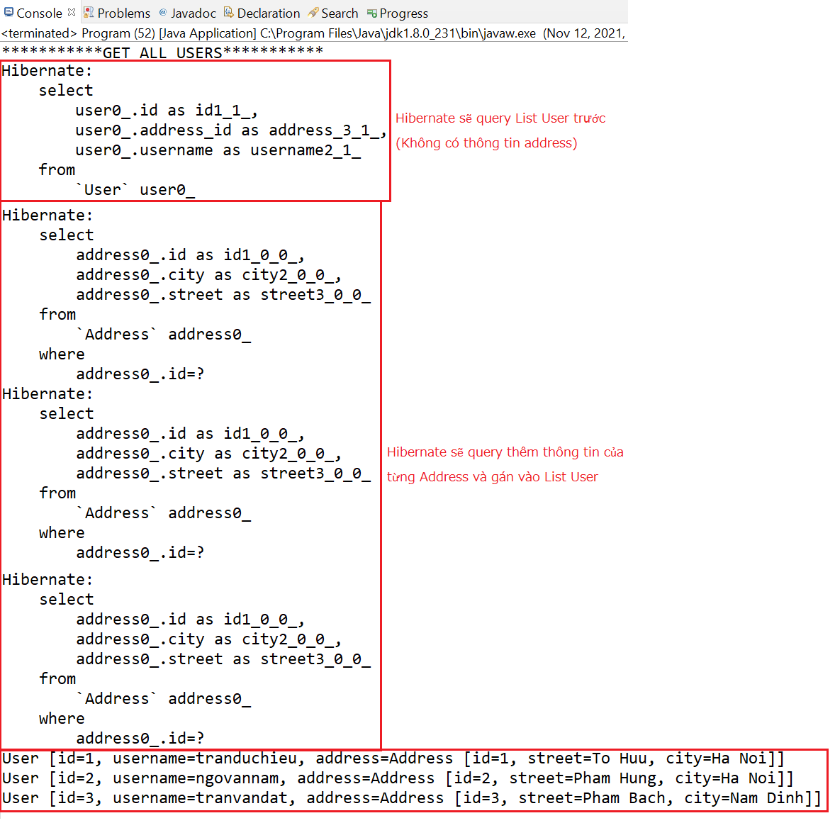
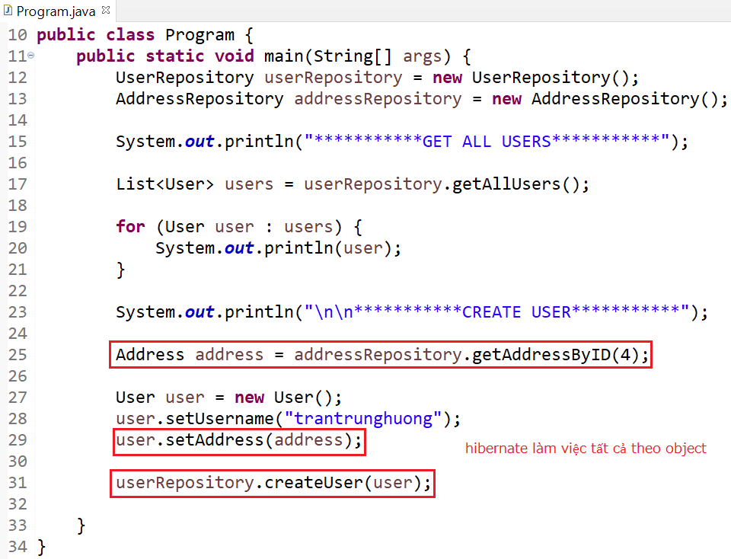
Foreign key
Select

Slide 12
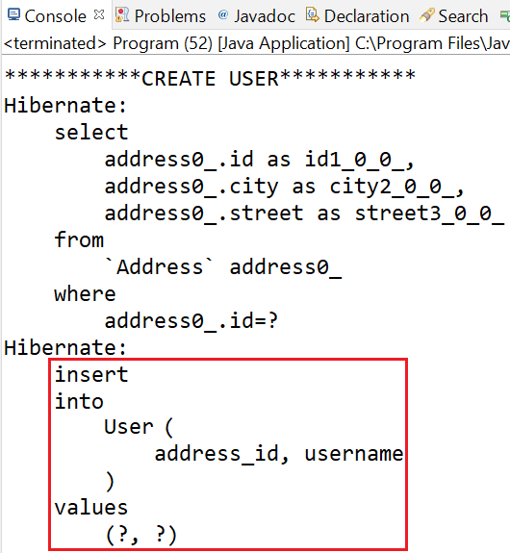
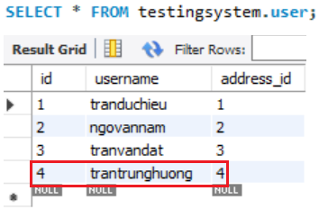
Foreign key
Create

Slide 13
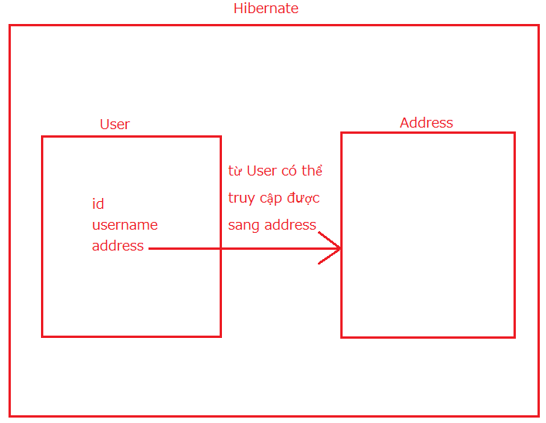
Foreign key
Summary

Slide 14
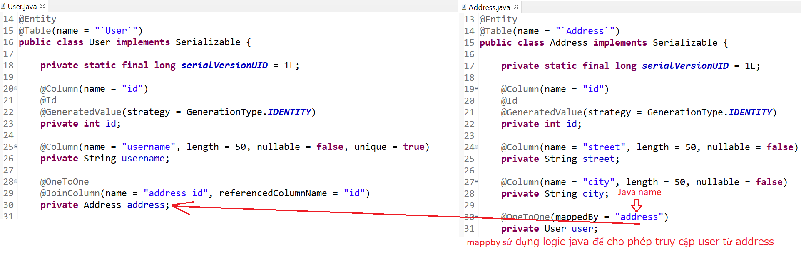
Foreign key
Example 2:

Slide 15
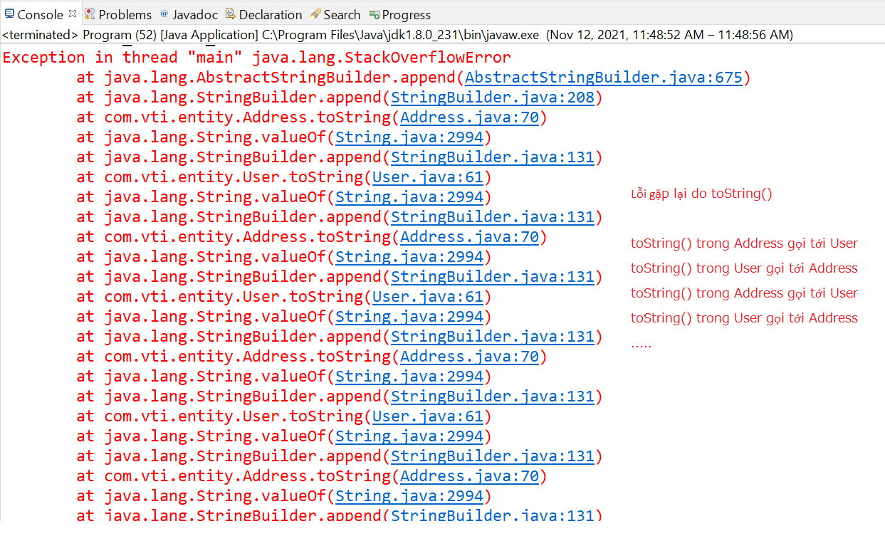
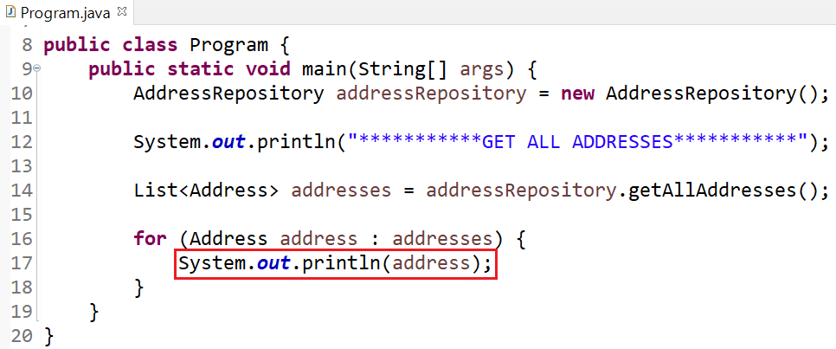
Foreign key

Slide 16
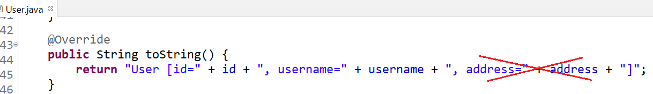
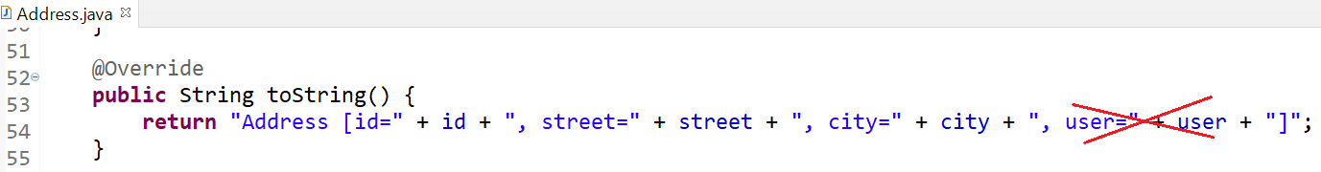
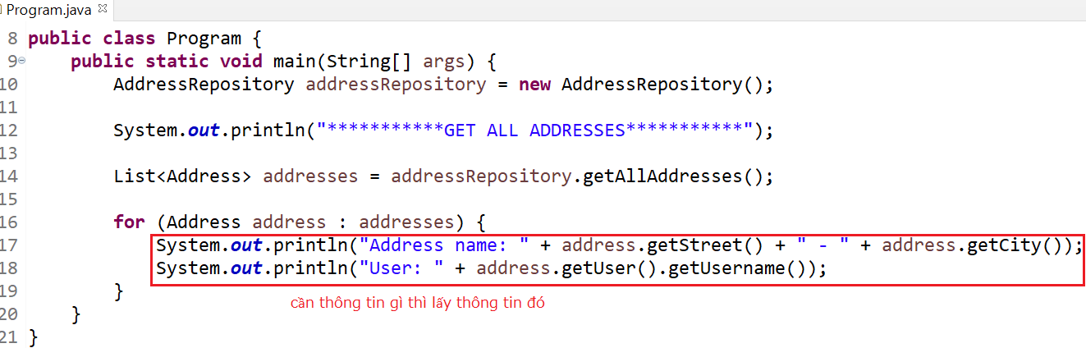
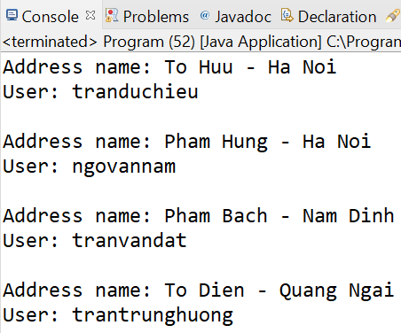
Foreign key
Fix
Edit toString()

Slide 17
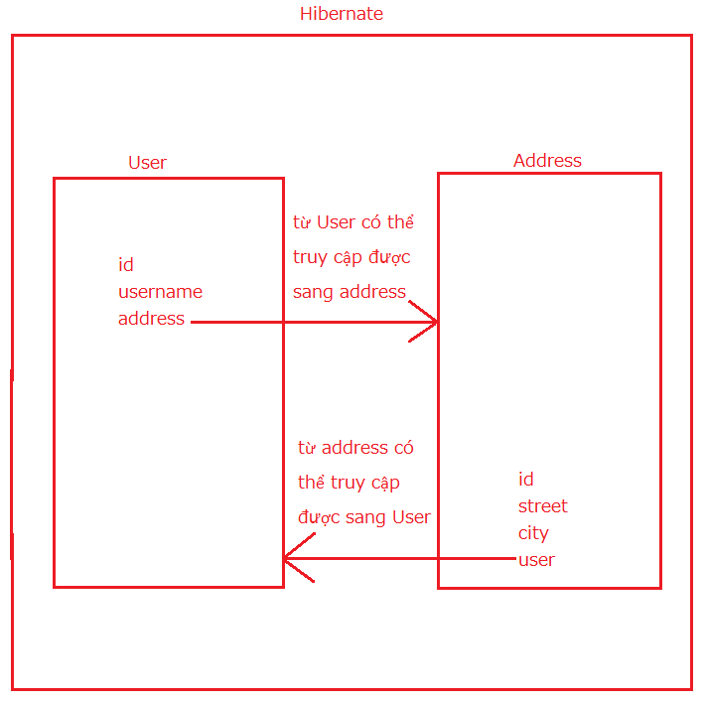
Foreign key
Summary

Slide 18
Testing System Assignment
Self-practice

Slide 19
Foreign key
@OneToMany
(Address) n - 1 (User)

Slide 20
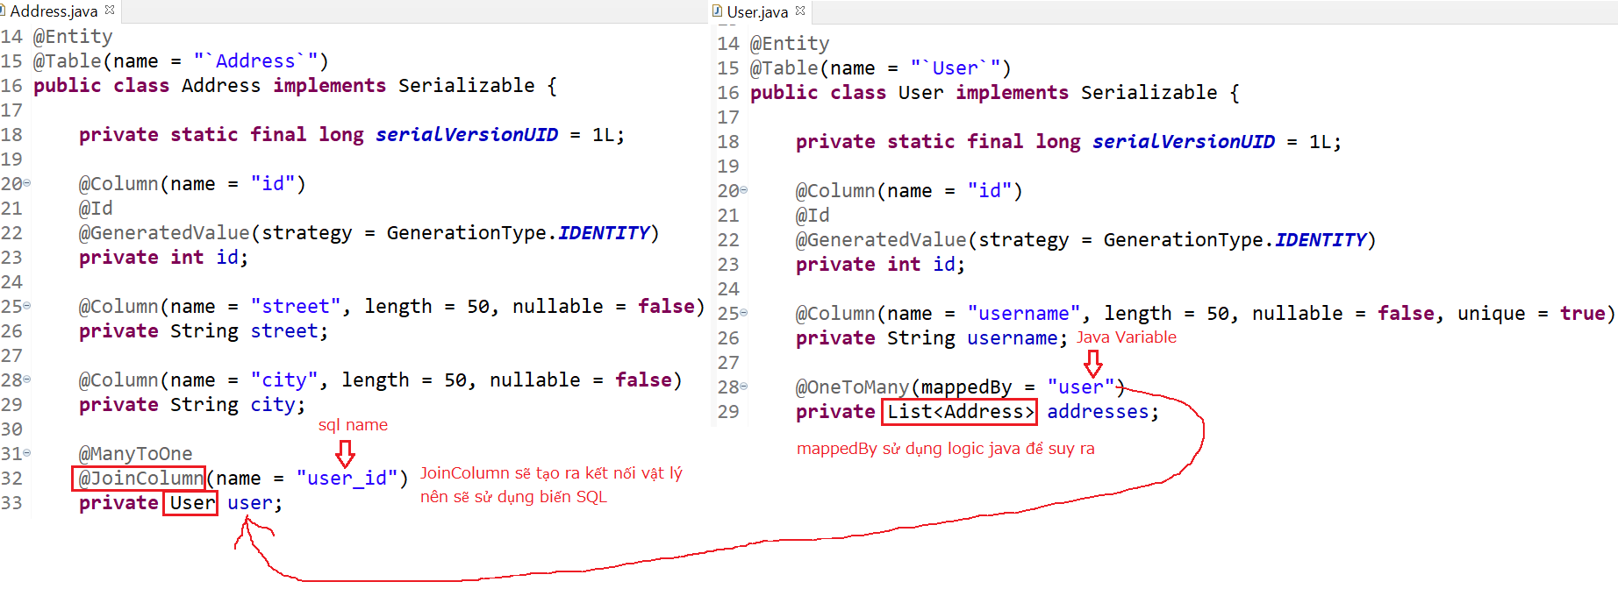
Foreign key
Entity

Slide 21
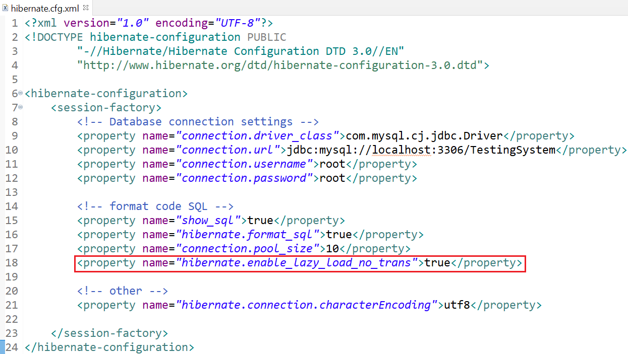
Foreign key
Config File

Slide 22
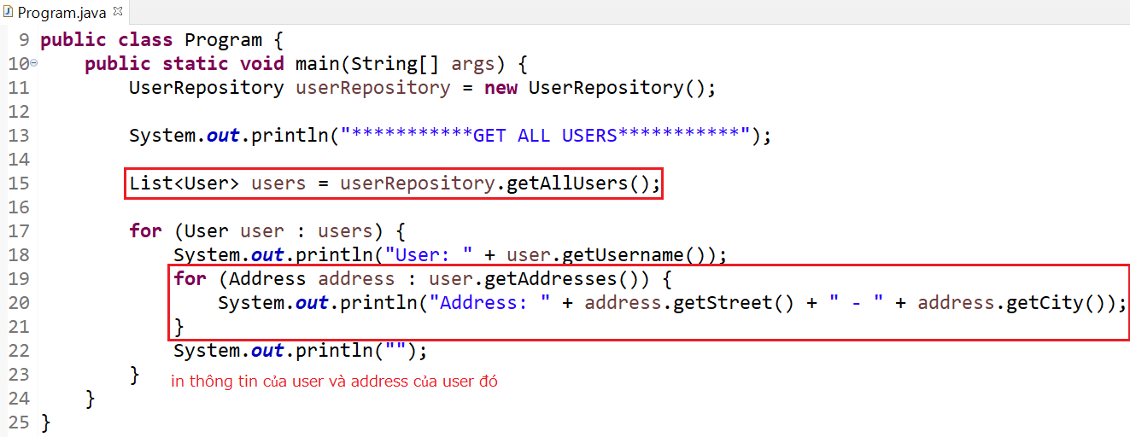
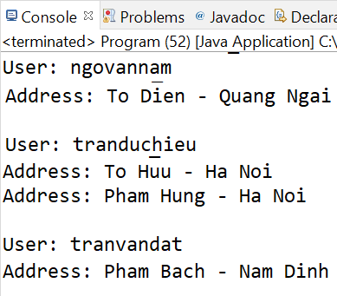
Foreign key

Slide 23
Testing System Assignment
Self-practice

Slide 24
Foreign key
@ManyToMany
3 Types
Basic
Using a Composite Key
New Entity

Slide 25
Foreign key
Basic

Slide 26
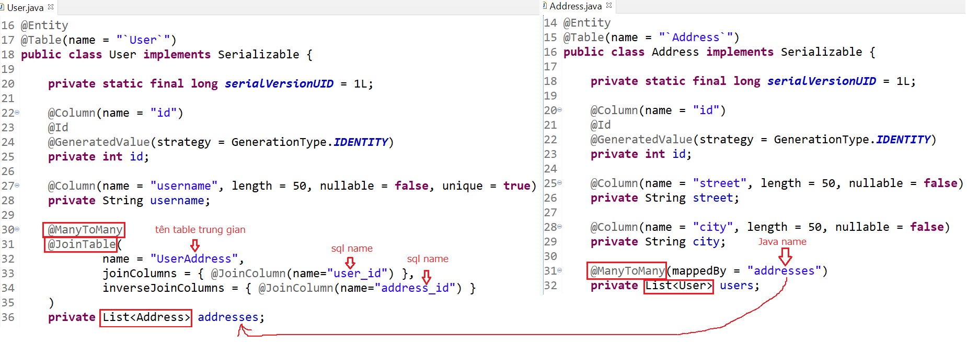
Foreign key
Entity

Slide 27
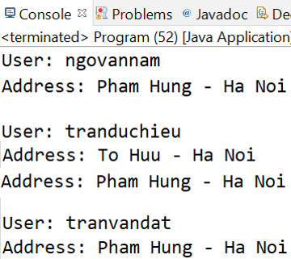
Foreign key

Slide 28
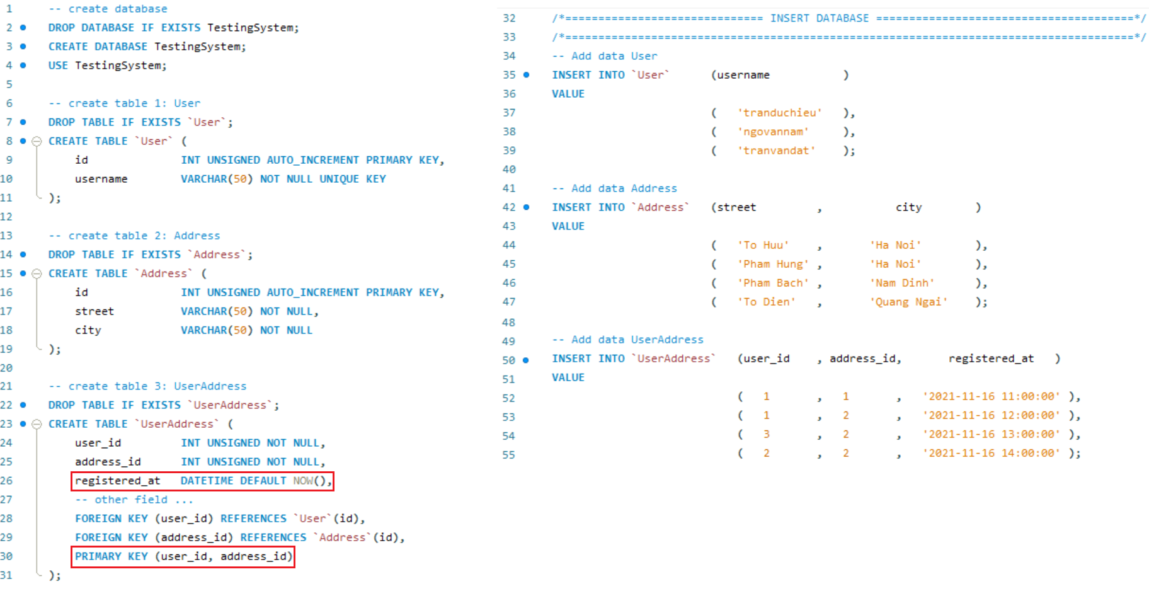
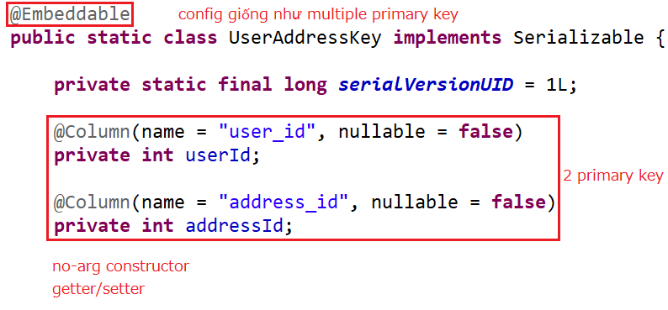
Foreign key
Using a Composite Key
Composite key

Slide 29
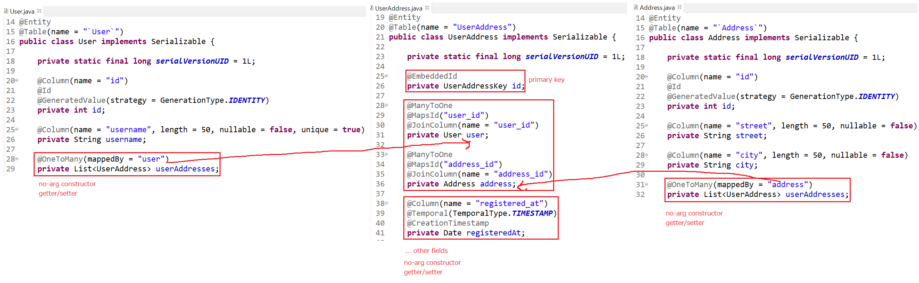
Foreign key
Entity

Slide 30
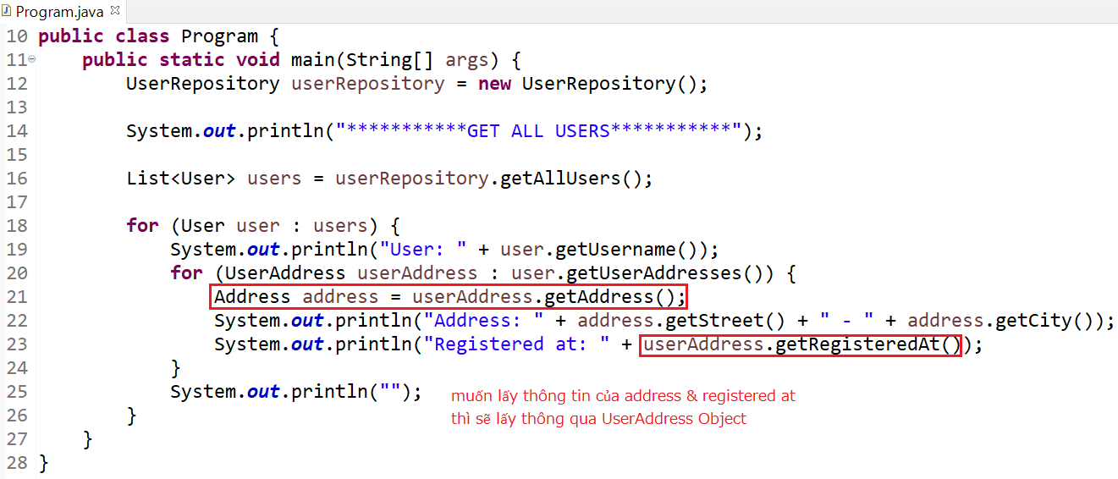
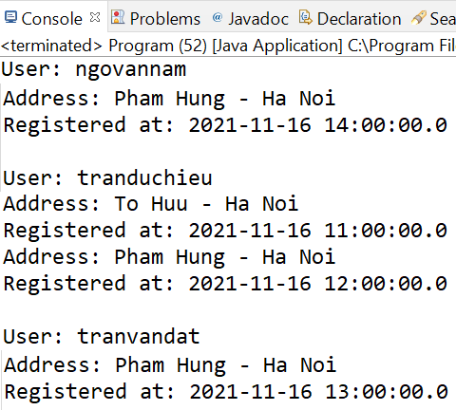
Foreign key

Slide 31
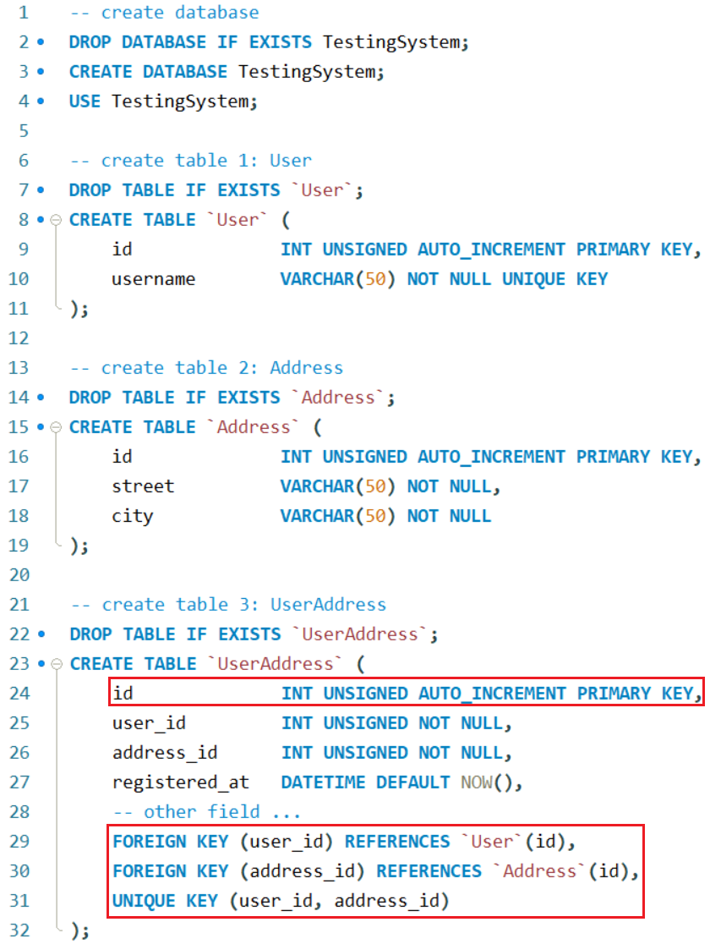
Foreign key
New Entity

Slide 32
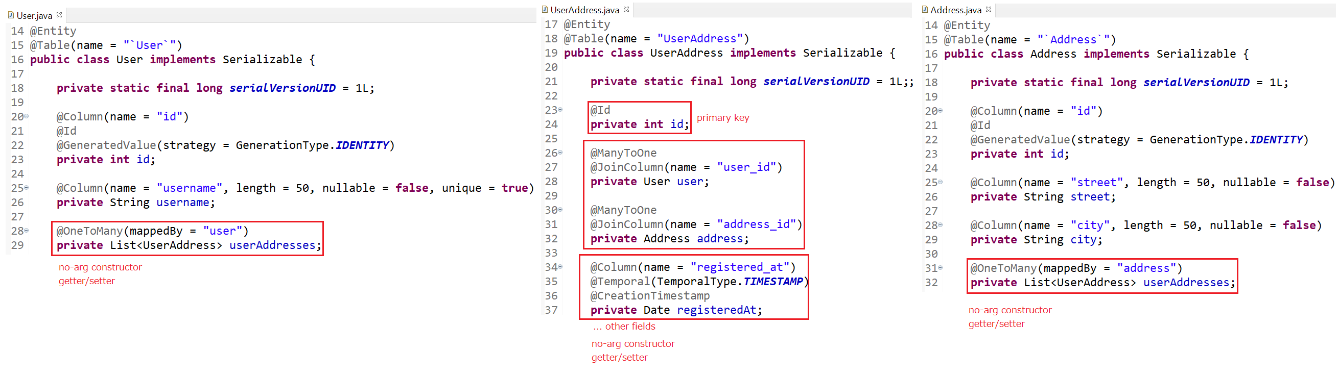
Foreign key
Entity

Slide 33
Foreign key

Slide 34
Testing System Assignment
Self-practice

Slide 35
Foreign key
Eager Loading
Lazy Loading

Slide 36
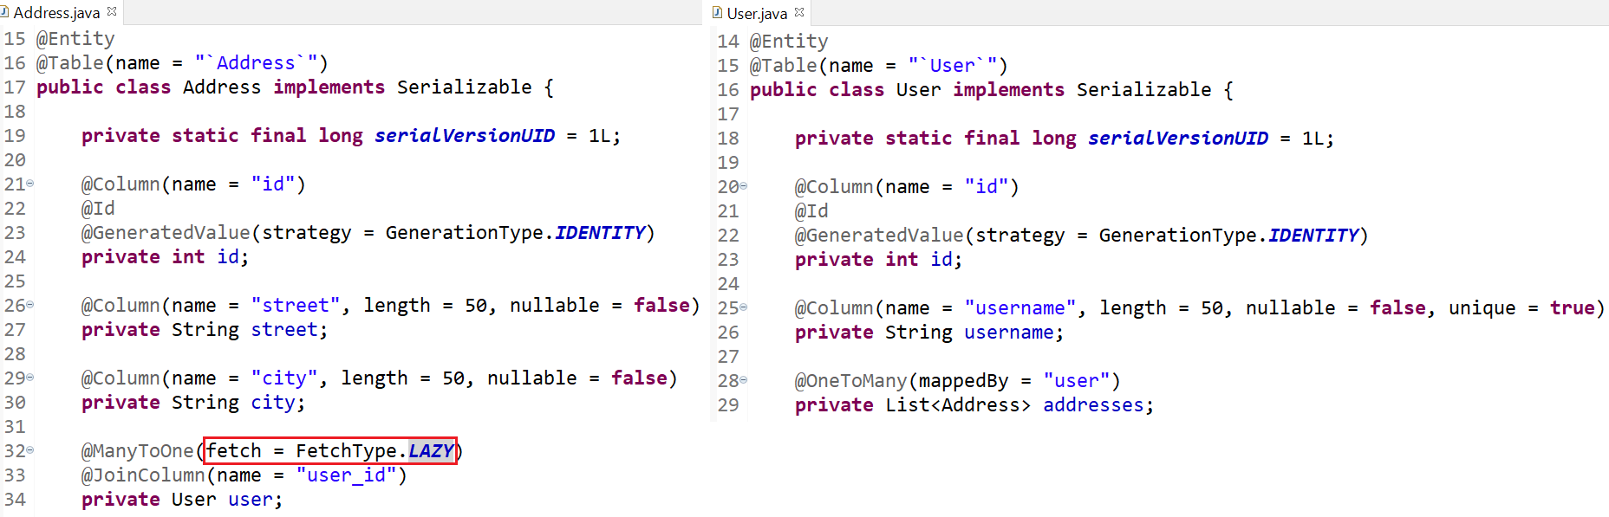
Foreign key
Lazy Loading
One To Many

Slide 37
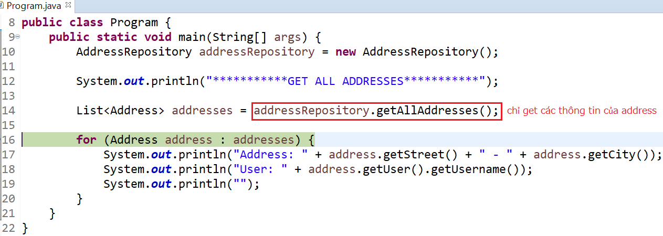
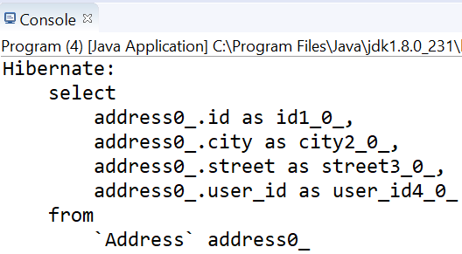
Foreign key
Debug mode

Slide 38
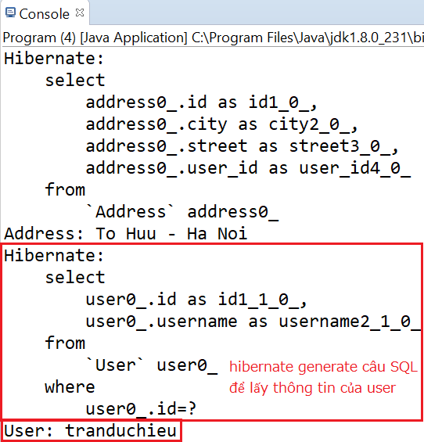
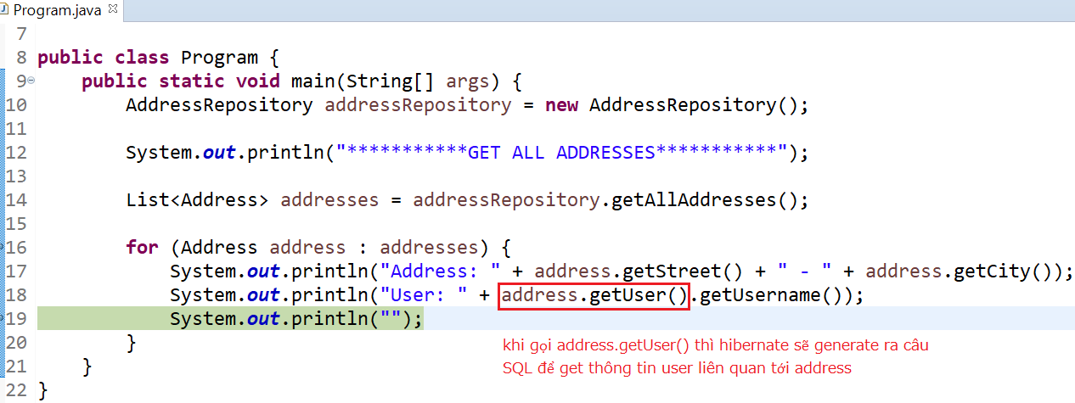
Foreign key

Slide 39
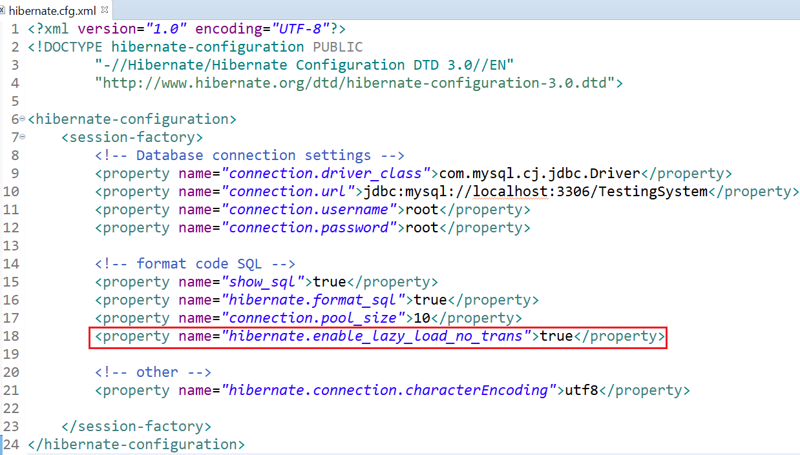
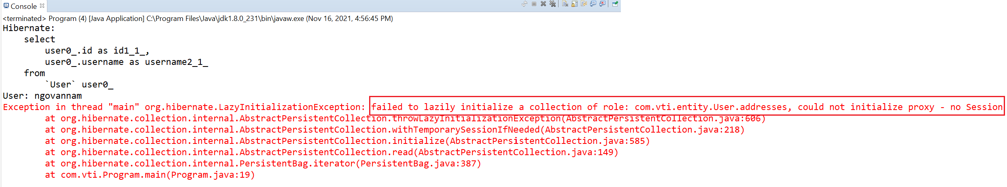
Foreign key
Fix error
Error
Fix

Slide 40
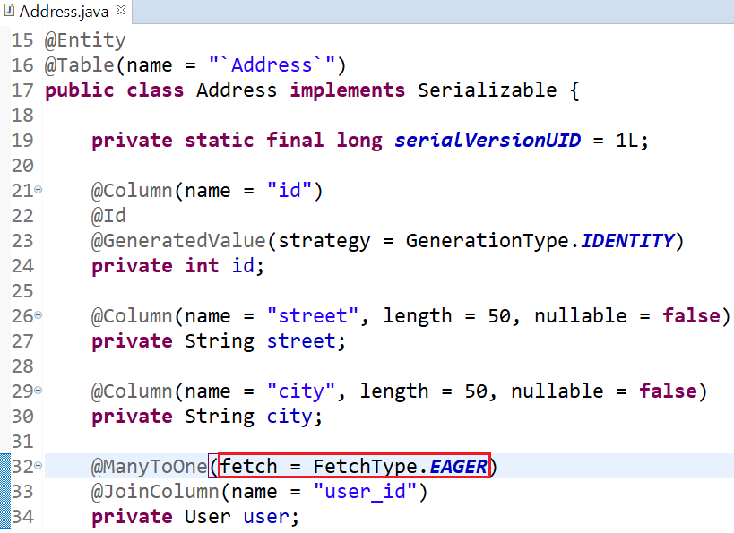
Foreign key
Eager Loading

Slide 41
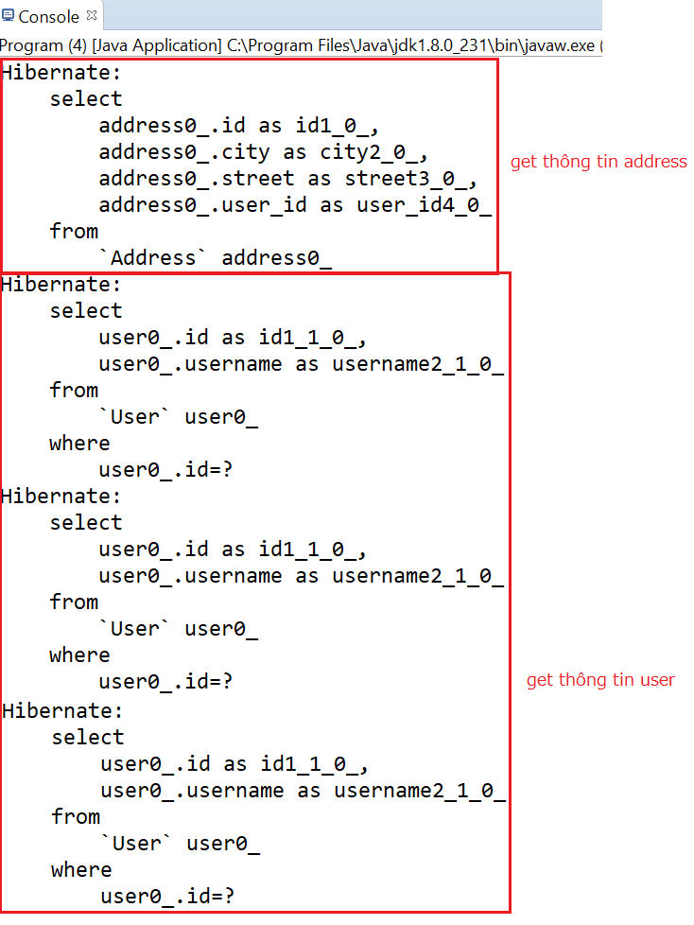
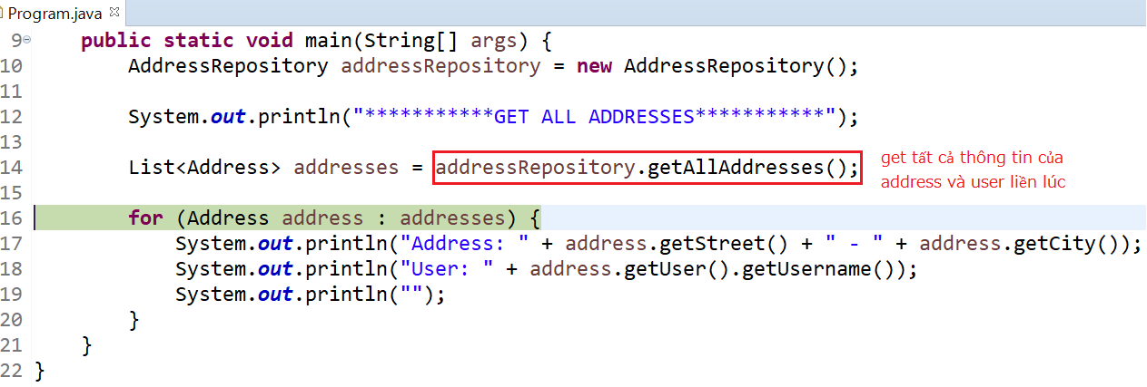
Foreign key

Slide 42
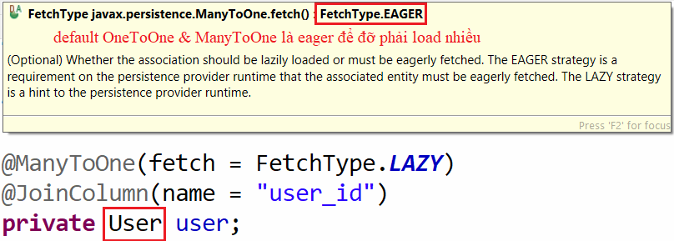
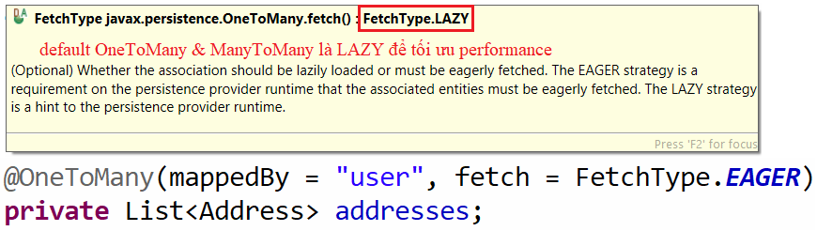
Testing System Assignment
Default
OneToOne, ManyToOne: EAGER
OneToMany, ManyToMany: Lazy

Slide 43
Testing System Assignment
Self-practice

Slide 44
Summary
@OneToOne
@OneToMany
@ManyToMany
@JoinColumn & mappedBy
Eager, Lazy Loading

Slide 45
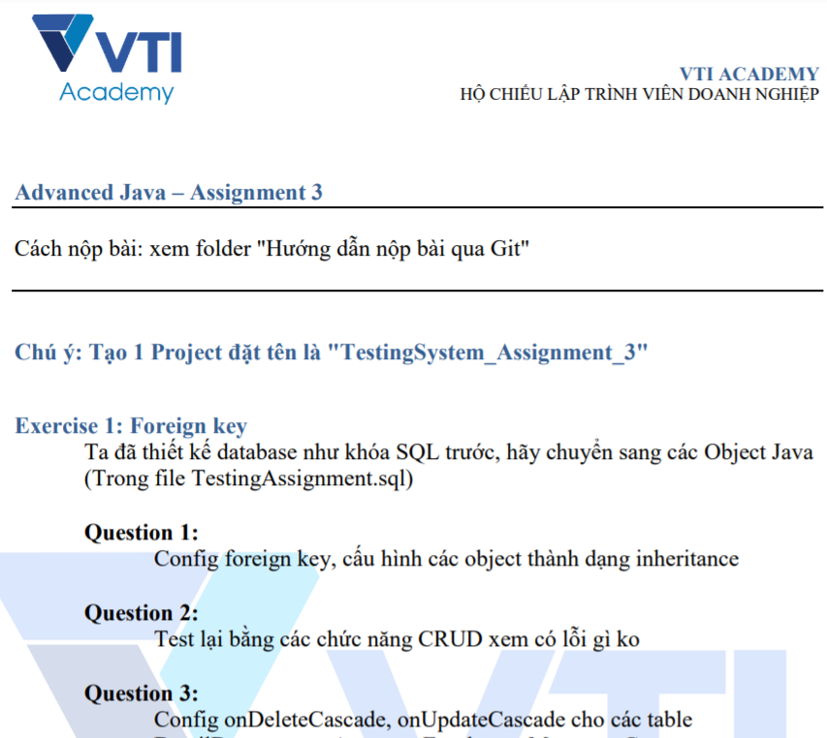
Testing System Assignments

Slide 46
Reference
https://www.javatpoint.com/hibernate-tutorial
https://www.baeldung.com/

Slide 47
Q & A
Copyright © VTI Academy All Rights Reserved

